Slide 1

15CSE313 Software Engineering
Lecture 6-7
Dr Ganesh Neelakanta Iyer
Associate Professor, Dept of Computer Science and Engg
Amrita Vishwa Vidyapeetham, Coimbatore

Slide 2
Process Models
Pressman R S, Bruce R.Maxim, “Software engineering - A Practitioner’s Approach”, Eighth Edition, Tata McGraw-Hill, 2014
Chapter 4: 4.1, 4.3

Slide 3
Recap
Topic
Generic Process Model
Defining a framework activity
Identifying a task set
Process Patterns
Process assessment and improvement
Personal and Team process models
Process Technology
Product and Process

Slide 4
Recap
A generic process model for software engineering encompasses a set of framework and umbrella activities, actions, and work tasks
Each of a variety of process models can be described by a different process flow
a description of how the framework activities, actions, and tasks are organized sequentially and chronologically
Process patterns can be used to solve common problems that are encountered as part of the software process

Slide 5
Recap
Personal and team models for the software process have been proposed
Both emphasize measurement, planning, and self-direction as key ingredients for a successful software process
Process technology tools allow a software organization to build an automated model of the process framework, task sets, and umbrella activities
The duality of product and process is one important element in keeping creative people engaged as software engineering continues to evolve

Slide 6
Topics Covered
Topic | Text Book Reference
Prescriptive Process Models | 4.1
The Unified Process | 4.3

Slide 7
Process Models
Process models were originally proposed to bring order to the chaos of software development
History has indicated that these models have brought a certain amount of useful structure to software engineering work and have provided a reasonably effective road map for software teams
However, software engineering work and the products that are produced remain on “the edge of chaos”

Slide 8
“the edge of chaos”
The edge of chaos is defined as “a natural state between order and chaos, a grand compromise between structure and surprise.”
The edge of chaos can be visualized as an unstable, partially structured state . . .
It is unstable because it is constantly attracted to chaos or to absolute order
Each process model described in this presentation tries to strike a balance between the need to impart order in a chaotic world and the need to be adaptable when things change constantly

Slide 9
Prescriptive Process Models
Chapter 4.1

Slide 10
Overview
A prescriptive process model strives for structure and order in software development
Activities and tasks occur sequentially with defined guidelines for progress
In prescriptive process approach in which order and project consistency are dominant issues

Slide 11
Overview
We call them “prescriptive” because they prescribe a set of process elements—framework activities, software engineering actions, tasks, work products, quality assurance, and change control mechanisms for each project
Each process model also prescribes a process flow (also called a work flow )—that is, the manner in which the process elements are interrelated to one another

Slide 12

The Waterfall Model

Slide 13



Slide 14


Slide 15


Slide 16
Waterfall Model
There are times when the requirements for a problem are well understood—
When work flows from communication through deployment in a reasonably linear fashion
This situation is sometimes encountered when well-defined adaptations or enhancements to an existing system must be made
E.g. An adaptation to billing software that has been mandated because of introducing GST
It may also occur in a limited number of new development efforts, but only when requirements are well defined and reasonably stable

Slide 17
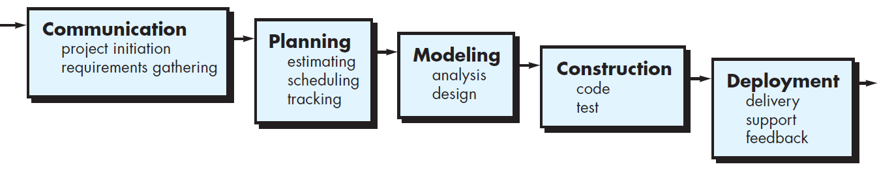
Waterfall Model Oldest paradigm for software engineering
The waterfall model, sometimes called the classic life cycle , suggests a systematic, sequential approach to software development that begins with customer specification of requirements and progresses through planning, modeling, construction, and deployment, culminating in ongoing support of the completed software

Slide 18
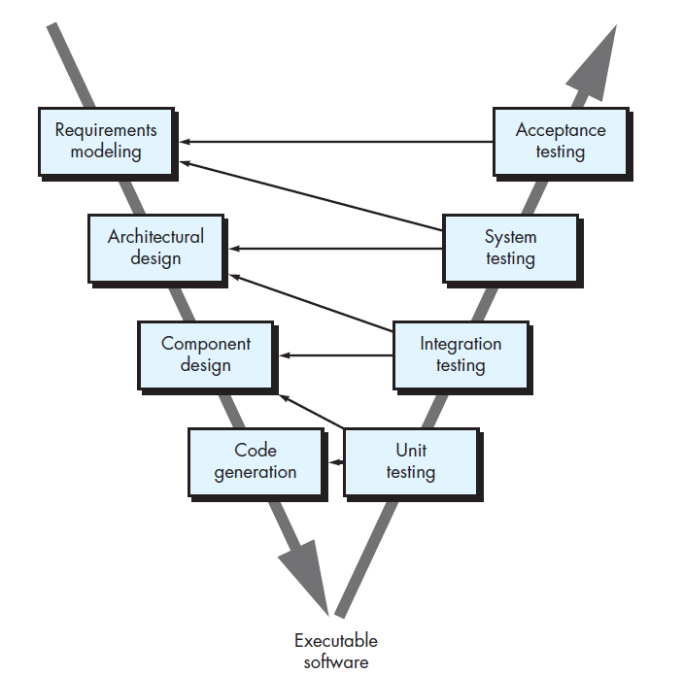
V-model
A variation in the representation of the waterfall model
It depicts the relationship of quality assurance actions to the actions associated with communication, modeling, and early construction activities

Slide 19
V-model
As a software team moves down the left side of the V, basic problem requirements are refined into progressively more detailed and technical representations of the problem and its solution

Slide 20
V-model
Once code has been generated, the team moves up the right side of the V, essentially performing a series of tests (quality assurance actions) that validate each of the models created as the team moves down the left side

Slide 21
V-model
In reality, there is no fundamental difference between the classic life cycle and the V-model
The V-model provides a way of visualizing how verification and validation actions are applied to earlier engineering work

Slide 22
Problems with Waterfall Model
Real projects rarely follow the sequential flow that the model proposes
Although the linear model can accommodate iteration, it does so indirectly
As a result, changes can cause confusion as the project team proceeds
It is often difficult for the customer to state all requirements explicitly
The waterfall model requires this and has difficulty accommodating the natural uncertainty that exists at the beginning of many projects

Slide 23
Problems with Waterfall Model
The customer must have patience
A working version of the program(s) will not be available until late in the project time span
A major blunder, if undetected until the working program is reviewed, can be disastrous
Leads to blocking states
Some project team members must wait for other members of the team to complete dependent tasks
In fact, the time spent waiting can exceed the time spent on productive work! The blocking state tends to be more prevalent at the beginning and end of a linear sequential process

Slide 24
Discussion
Provide three examples of software projects that would be amenable to the waterfall model. Be specific.
Notes:
For big projects and in crucial systems such as civil or medical, they plan everything before doing so. Why? because these system are critical with lots of many regulations, sometimes related to governments. And, you have to make sure there is no mistakes. And, if there is, you may face with the regulations. Such as banking systems, you cannot write to code without planning. One error in customer transaction, you could go jail
Developing a calculator
existing employ payroll system ,if the payroll computing mechanism has to be changed we go for waterfall model

Slide 25
Incremental Process Models
There are many situations in which initial software requirements are reasonably well defined, but the overall scope of the development effort precludes a purely linear process
In addition, there may be a compelling need to provide a limited set of software functionality to users quickly and then refine and expand on that functionality in later software releases
In such cases, you can choose a process model that is designed to produce the software in increments

Slide 26
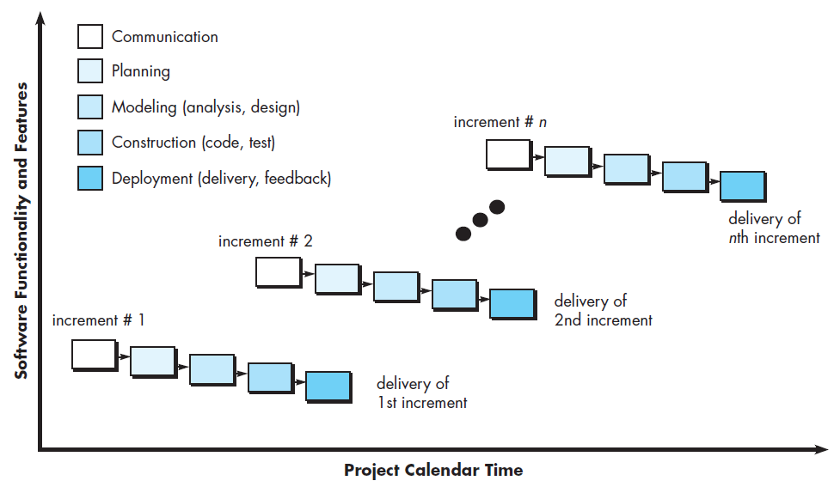
Incremental Process Models

Slide 27
Incremental Process Models
The incremental model combines the elements of linear and parallel process flows discussed earlier
The incremental model applies linear sequences in a staggered fashion as calendar time progresses
Each linear sequence produces deliverable “increments” of the software

Slide 28

Example
Basic file management, editing, and document production functions in the first increment
More sophisticated editing and document production capabilities in the second increment
Spelling and grammar checking in the third increment
Advanced page layout capability in the fourth increment
It should be noted that the process flow for any increment can incorporate the prototyping paradigm discussed in the next subsection

Slide 29
Incremental Process Models
When an incremental model is used, the first increment is often a core product
That is, basic requirements are addressed but many supplementary features (some known, others unknown) remain undelivered
The core product is used by the customer (or undergoes detailed evaluation)
As a result of use and/or evaluation, a plan is developed for the next increment
The plan addresses the modification of the core product to better meet the needs of the customer and the delivery of additional features and functionality
This process is repeated following the delivery of each increment, until the complete product is produced

Slide 30
Discussion
Provide three examples of software projects that would be amenable to the incremental model. Be specific.
Notes:
It is more or less same as Agile. Any current day application development (Web/Mobile/Cloud) falls under this category
Gmail
Facebook
Google docs
Whatssap
Windows
Plenty of such examples

Slide 31
Summary
Prescriptive process models have been applied for many years in an effort to bring order and structure to software development
Each of these models suggests a somewhat different process flow, but all perform the same set of generic framework activities: communication, planning, modeling, construction, and deployment.
Sequential process models, such as the waterfall and V-models, are the oldest software engineering paradigms.
They suggest a linear process flow that is often inconsistent with modern realities (e.g., continuous change, evolving systems, tight time lines) in the software world
They do, however, have applicability in situations where requirements are well defined and stable.
Incremental process models are iterative in nature and produce working versions of software quite rapidly

Slide 32
Evolutionary Process Models
Software, like all complex systems, evolves over a period of time
Business and product requirements often change as development proceeds, making a straight line path to an end product unrealistic
Tight market deadlines make completion of a comprehensive software product impossible, but a limited version must be introduced to meet competitive or business pressure
A set of core product or system requirements is well understood, but the details of product or system extensions have yet to be defined
In these and similar situations, you need a process model that has been explicitly designed to accommodate a product that grows and changes
Evolutionary models are iterative
They are characterized in a manner that enables you to develop increasingly more complete versions of the software

Slide 33
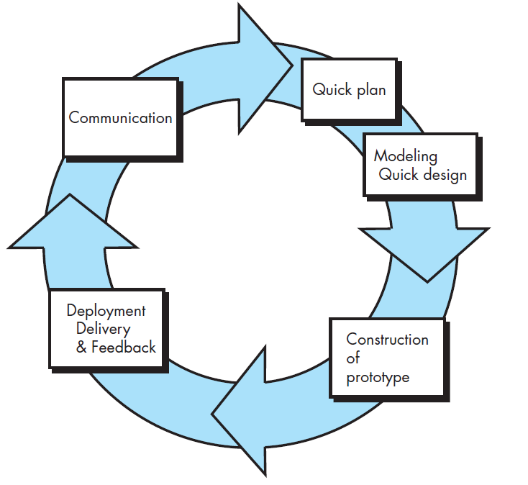
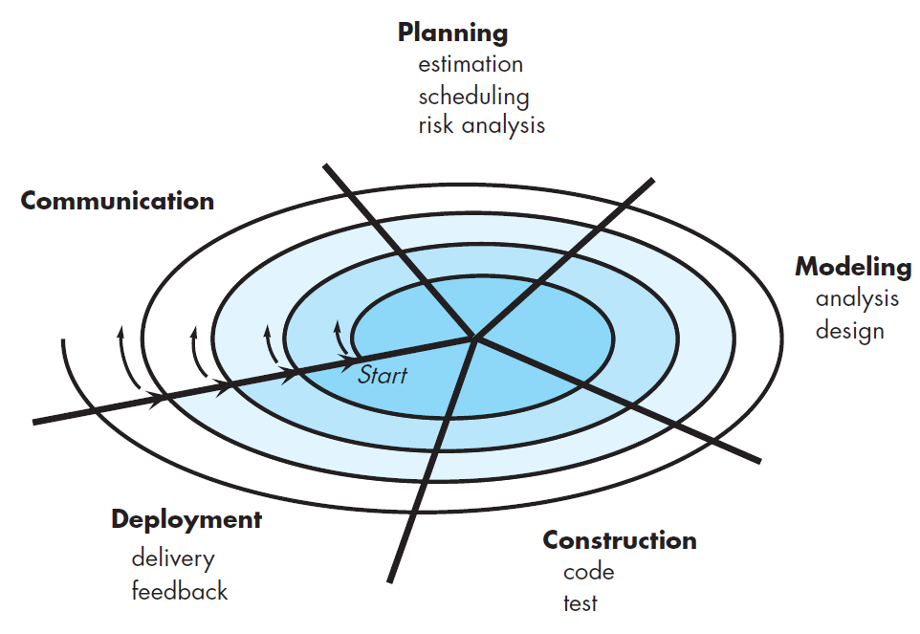
Two common evolutionary models
Prototyping
Spiral

Slide 34
Prototyping
Often, a customer defines a set of general objectives for software, but does not identify detailed requirements for functions and features
In other cases, the developer may be unsure of the efficiency of an algorithm, the adaptability of an operating system, or the form that human-machine interaction should take
In these, and many other situations, a prototyping paradigm may offer the best approach

Slide 35
Prototyping
Although prototyping can be used as a stand-alone process model, it is more commonly used as a technique that can be implemented within the context of any one of the process models noted earlier
Regardless of the manner in which it is applied, the prototyping paradigm assists you and other stakeholders to better understand what is to be built when requirements are fuzzy

Slide 36
Prototyping
The prototyping paradigm begins with communication
You meet with other stakeholders to define the overall objectives for the software, identify whatever requirements are known, and outline areas where further definition is mandatory
A prototyping iteration is planned quickly, and modeling (in the form of a “quick design”) occurs
A quick design focuses on a representation of those aspects of the software that will be visible to end users (e.g., human interface layout or output display formats).

Slide 37
Prototyping
The quick design leads to the construction of a prototype
The prototype is deployed and evaluated by stakeholders, who provide feedback that is used to further refine requirements
Iteration occurs as the prototype is tuned to satisfy the needs of various stakeholders, while at the same time enabling you to better understand what needs to be done.

Slide 38
Prototyping
Ideally, the prototype serves as a mechanism for identifying software requirements
If a working prototype is to be built, you can make use of existing program fragments or apply tools that enable working programs to be generated quickly
Both stakeholders and software engineers like the prototyping paradigm
Users get a feel for the actual system, and developers get to build something immediately.

Slide 39
Prototyping – Issues
Stakeholders see what appears to be a working version of the software, unaware that the prototype is held together haphazardly, unaware that in the rush to get it working you haven't considered overall software quality or long-term maintainability
As a software engineer, you often make implementation compromises in order to get a prototype working quickly. An inappropriate operating system or programming language may be used simply because it is available and known; an inefficient algorithm may be implemented simply to demonstrate capability

Slide 40
Discussion
Provide three examples of software projects that would be amenable to the prototyping model. Be specific.

Slide 41
Discussion
What process adaptations are required if the prototype will evolve into a delivery system or product?

Slide 42
The Spiral Model
The spiral model is an evolutionary software process model that couples the iterative nature of prototyping with the controlled and systematic aspects of the waterfall model
It provides the potential for rapid development of increasingly more complete versions of the software

Slide 43
The Spiral Model
The spiral development model is a risk -driven process model generator that is used to guide multi-stakeholder concurrent engineering of software intensive systems
It has two main distinguishing features
One is a cyclic approach for incrementally growing a system’s degree of definition and implementation while decreasing its degree of risk
The other is a set of anchor point milestones for ensuring stakeholder commitment to feasible and mutually satisfactory system solutions

Slide 44
The Spiral Model
Using the spiral model, software is developed in a series of evolutionary releases
During early iterations, the release might be a model or prototype
During later iterations, increasingly more complete versions of the engineered system are produced

Slide 45
The Spiral Model
Using the spiral model, software is developed in a series of evolutionary releases
During early iterations, the release might be a model or prototype
During later iterations, increasingly more complete versions of the engineered system are produced
A spiral model is divided into a set of framework activities defined by the software engineering team

Slide 46
The Spiral Model
The first circuit around the spiral might result in the development of a product specification
Subsequent passes around the spiral might be used to develop a prototype and then progressively more sophisticated versions of the software
Each pass through the planning region results in adjustments to the project plan
Cost and schedule are adjusted based on feedback derived from the customer after delivery
In addition, the project manager adjusts the planned number of iterations required to complete the software

Slide 47
The Spiral Model
The spiral model is a realistic approach to the development of large-scale systems and software
Because software evolves as the process progresses, the developer and customer better understand and react to risks at each evolutionary level
The spiral model uses prototyping as a risk reduction mechanism but, more important, enables you to apply the prototyping approach at any stage in the evolution of the product
It maintains the systematic stepwise approach suggested by the classic life cycle but incorporates it into an iterative framework that more realistically reflects the real world
The spiral model demands a direct consideration of technical risks at all stages of the project and, if properly applied, should reduce risks before they become problematic

Slide 48
Discussion
As you move outward along the spiral process flow, what can you say about the software that is being developed or maintained?

Slide 49
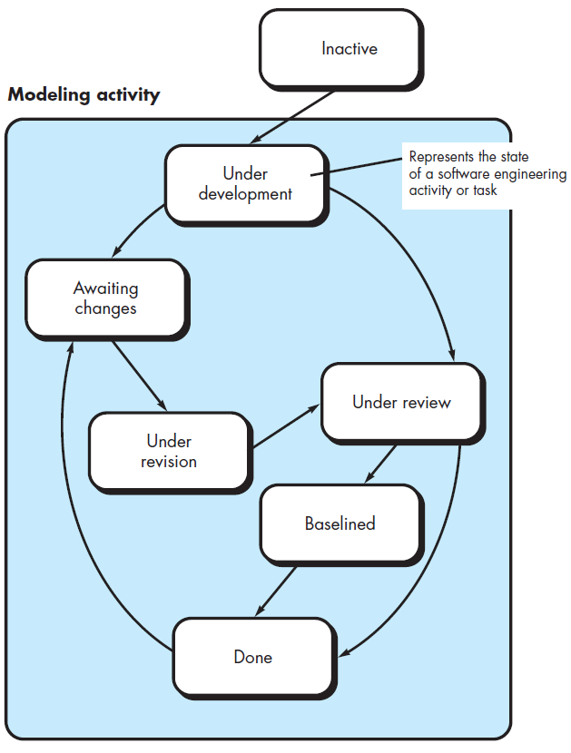
Concurrent Models
The concurrent development model, sometimes called concurrent engineering, allows a software team to represent iterative and concurrent elements of any of the process models described earlier
For example, early in a project the communication activity (not shown in the figure) has completed its first iteration and exists in the awaiting changes state
The modeling activity (which existed in the none state while initial communication was completed) now makes a transition into the under development state
If, however, the customer indicates that changes in requirements must be made, the modeling activity moves from the under development state into the awaiting changes state

Slide 50
Concurrent Models
Concurrent modeling defines a series of events that will trigger transitions from state to state for each of the software engineering activities, actions, or tasks
For example, during early stages of design (a major software engineering action that occurs during the modeling activity), an inconsistency in the requirements model is uncovered
This generates the event analysis model correction, which will trigger the requirements analysis action from the done state into the awaiting changes state

Slide 51
Concurrent Models
Concurrent modeling is applicable to all types of software development and provides an accurate picture of the current state of a project
Rather than confining software engineering activities, actions, and tasks to a sequence of events, it defines a process network
Each activity, action, or task on the network exists simultaneously with other activities, actions, or tasks
Events generated at one point in the process network trigger transitions among the states associated with each activity

Slide 52
Discussion
The concurrent process model defines a set of “states.” Describe what these states represent in your own words, and then indicate how they come into play within the concurrent process model

Slide 53
Summary
Evolutionary process models recognize the iterative, incremental nature of most software engineering projects and are designed to accommodate change
Evolutionary models, such as prototyping and the spiral model, produce incremental work products (or working versions of the software) quickly
These models can be adopted to apply across all software engineering activities—from concept development to long-term system maintenance
The concurrent process model allows a software team to represent iterative and concurrent elements of any process model.

Slide 54
The Unified Process

Slide 55
The Unified Process
An attempt to draw on the best features and characteristics of traditional software process models, but characterize them in a way that implements many of the best principles of agile software development
The Unified Process recognizes the importance of customer communication and streamlined methods for describing the customer’s view of a system (the use case)
It emphasizes the important role of software architecture and “helps the architect focus on the right goals, such as understandability, reliance to future changes, and reuse”
It suggests a process flow that is iterative and incremental, providing the evolutionary feel that is essential in modern software development

Slide 56
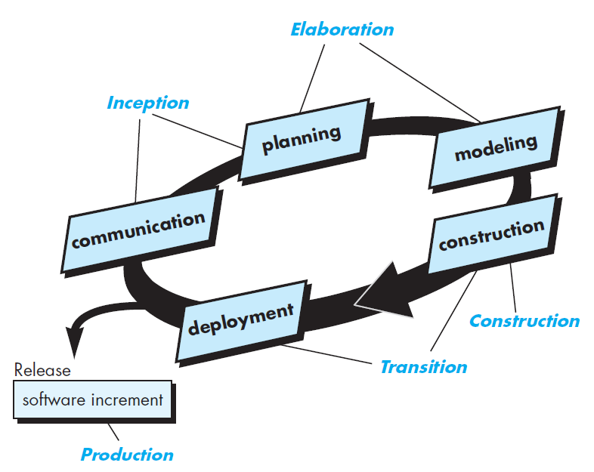
Phases of the Unified Process (UP)
This figure depicts the “phases” of the UP and relates them to the generic activities that have been discussed earlier

Slide 57
Inception Phase
The inception phase of the UP encompasses both customer communication and planning activities
By collaborating with stakeholders, business requirements for the software are identified; a rough architecture for the system is proposed; and a plan for the iterative, incremental nature of the ensuing project is developed
Fundamental business requirements are described through a set of preliminary use cases that describe which features and functions each major class of users desires
Architecture at this point is nothing more than a tentative outline of major subsystems and the functions and features that populate them
Later, the architecture will be refined and expanded into a set of models that will represent different views of the system. Planning identifies resources, assesses major risks, defines a schedule, and establishes a basis for the phases that are to be applied as the software increment is developed

Slide 58
The Elaboration Phase
The elaboration phase encompasses the communication and modeling activities of the generic process model
Elaboration refines and expands the preliminary use cases that were developed as part of the inception phase and expands the architectural representation to include five different views of the software—the use case model, the analysis model, the design model, the implementation model, and the deployment model
In some cases, elaboration creates an “executable architectural baseline” that represents a “first cut” executable system
The architectural baseline demonstrates the viability of the architecture but does not provide all features and functions required to use the system
In addition, the plan is carefully reviewed at the culmination of the elaboration phase to ensure that scope, risks, and delivery dates remain reasonable
Modifications to the plan are often made at this time

Slide 59
The Construction Phase
The construction phase of the UP is identical to the construction activity defined for the generic software process
Using the architectural model as input, the construction phase develops or acquires the software components that will make each use case operational for end users
To accomplish this, analysis and design models that were started during the elaboration phase are completed to reflect the final version of the software increment
All necessary and required features and functions for the software increment (i.e., the release) are then implemented in source code
As components are being implemented, unit tests are designed and executed for each
In addition, integration activities (component assembly and integration testing) are conducted
Use cases are used to derive a suite of acceptance tests that are executed prior to the initiation of the next UP phase

Slide 60
The Transition Phase
The transition phase of the UP encompasses the latter stages of the generic construction activity and the first part of the generic deployment (delivery and
feedback) activity
Software is given to end users for beta testing, and user feedback reports both defects and necessary changes
In addition, the software team creates the necessary support information (e.g., user manuals, troubleshooting guides, installation procedures) that is required for the release
At the conclusion of the transition phase, the software increment becomes a usable software release

Slide 61
The Production Phase
The production phase of the UP coincides with the deployment activity of the generic process
During this phase, the ongoing use of the software is monitored, support for the operating environment (infrastructure) is provided, and defect reports and requests for changes are submitted and evaluated

Slide 62
UP – Some notes
It is likely that at the same time the construction, transition, and production phases are being conducted, work may have already begun on the next software increment
This means that the five UP phases do not occur in a sequence, but rather with staggered concurrency
A software engineering workflow is distributed across all UP phases
In the context of UP, a workflow is analogous to a task set
That is, a workflow identifies the tasks required to accomplish an important software engineering action and the work products that are produced as a consequence of successfully completing the tasks
It should be noted that not every task identified for a UP workflow is conducted for every software project
The team adapts the process (actions, tasks, subtasks, and work products) to meet its needs

Slide 63
Discussion
Is it possible to combine process models? If so, provide an example

Slide 64
Discussion
What are the advantages and disadvantages of developing software in which quality is “good enough”? That is, what happens when we emphasize development speed over product quality?

Slide 65
Summary
The Unified Process is a “use case driven, architecture-centric, iterative and incremental” software process designed as a framework for UML methods and tools

